Slide 1

STUPA ARCHITECHE: SANCHI

Slide 3
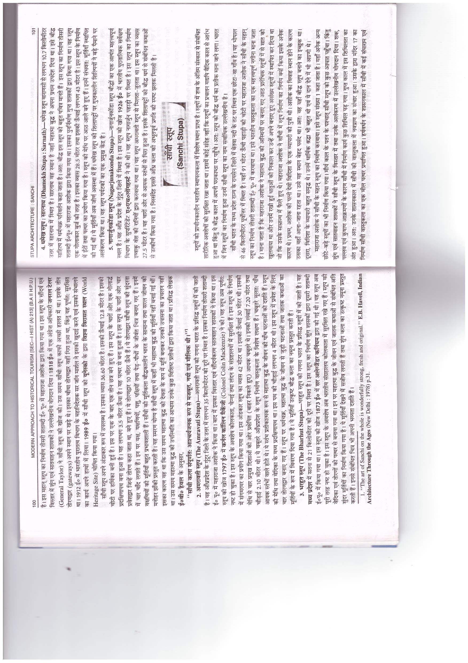

Slide 5
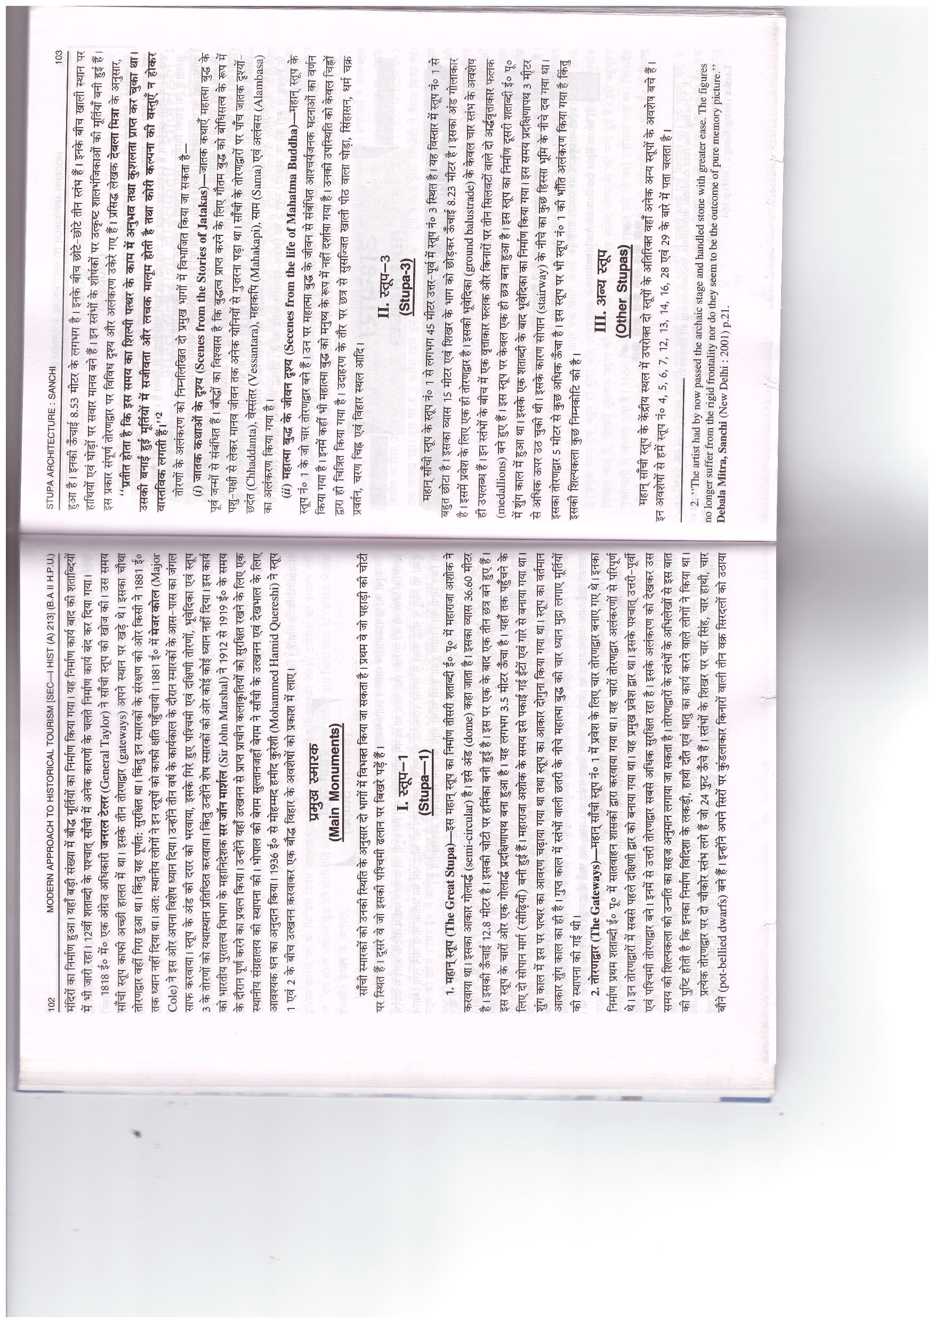

Slide 7
